Slide 1
Bank Marketing Data Analysis & Prediction
By
Odu Nkem
Techrative Technology Limited
Instructor: Isoughie Mandela
July, 2026

Slide 2
OUTLINE
Introduction
Problem Statement
Aim and Objectives
Methodology
Descriptive Analysis
Results and Discussion
Ethical Guidelines
Conclusion and Recommendation

Slide 3
INTRODUCTION
Bank campaign data analysis involves examining customer demographics and previous interactions to identify clients who are most likely to respond positively to marketing efforts.
To enable a shift from intuition-driven to evidence-based decision-making, banking institutions must analyze customer behavior toward their products and services using effective marketing strategies. This forms the basis of this study.
In this project, particular attention is given to the marketing campaigns of a Portuguese banking institution, which relied on phone calls to predict client subscription to a term deposit captured by the target variable ‘y’, indicating either ‘yes’ or ‘no’.

Slide 4
PROBLEM STATEMENT
Despite large outreach efforts, low subscription rates remain a challenge. The bank lacks efficient targeting strategies to improve campaign effectiveness.
Therefore, the Portuguese bank dataset needs analytics.

Slide 5
AIM AND OBJECTIVES
The main aim is to improve subscription rates and the objectives are:
Analyze client behavior in term deposit marketing campaigns
Identify patterns and build predictive models
Provide segmentation and contact strategy insights
Explore temporal trends in marketing campaign success
Create customer profiles
Improve marketing strategy

Slide 6
METHODOLOGY
Data Collection Portuguese Bank Dataset
Data Preparation
Import Libraries
Load Dataset
Fig. 1: Workflow
Data Preprocessing
Exploratory Data Analysis
Modeling
Inspection & Cleaning
Descriptive Statistics
Logistic Regression
Segmentation Analysis
Decision Tree
Handle “unknown” Features
Random Forest
Temporal Analysis
Encoding (one-Hot)
Customer Profiling
XGBoost
Contact Strategy
80/20 Train test split
SMOTE for Imbalance
Visualizations
Evaluation
Interpretation
Conclusion
Recommendation

Slide 7
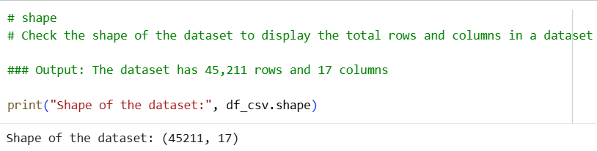
DESCRIPTIVE ANALYSIS
Source: Portuguese Bank Marketing Campaigns
Records: 45,211 clients who were contacted through phone calls; 17 features.
Variables: Numeric and Categorical Features
Data Types: Integers and object

Slide 8
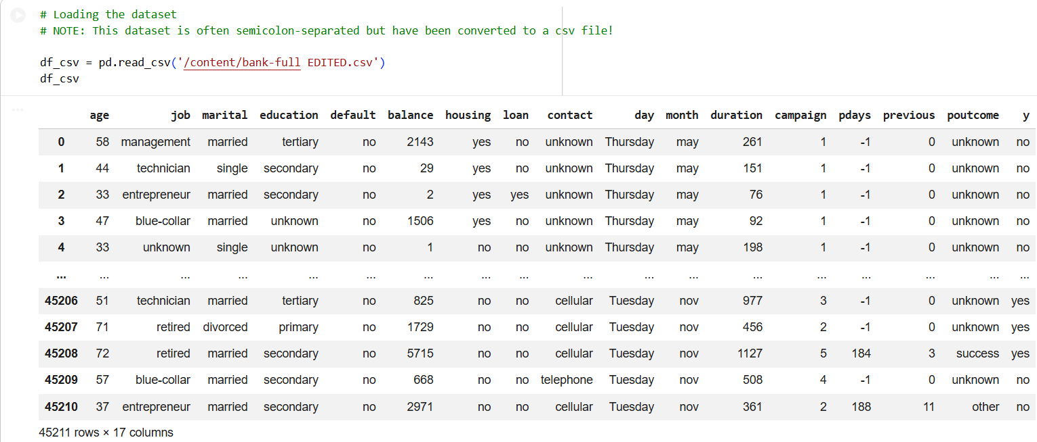
DESCRIPTIVE ANALYSIS CONT’D
Table 1: Bank Dataset on Colab environment

Slide 9
DESCRIPTIVE ANALYSIS
The bank dataset includes detailed information on client:
Demographics: age, job, marital, and education
Financial status: Has credit in default, housing loan, or a personal loan
Past interactions: Contact type, month, day_of_week, and duration
Campaign History: Number of contacts made during and before this campaign
Pdays: Number of days passed since the client was last contacted from a previous campaign
Previous: Number of contacts made before this campaign and for this client (numeric).
Poutcome: Outcome of the previous marketing campaign
- Target Variable ‘y’: indicates if the client subscribed to a term deposit (yes or no)

Slide 10
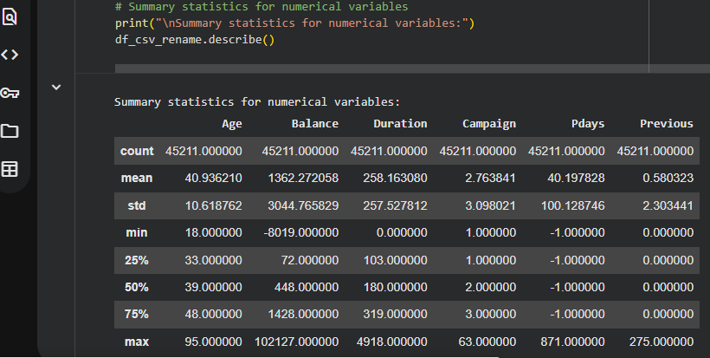
DESCRIPTIVE ANALYSIS
Table 2: Summary statistics of the Bank Dataset on Colab environment

Slide 11
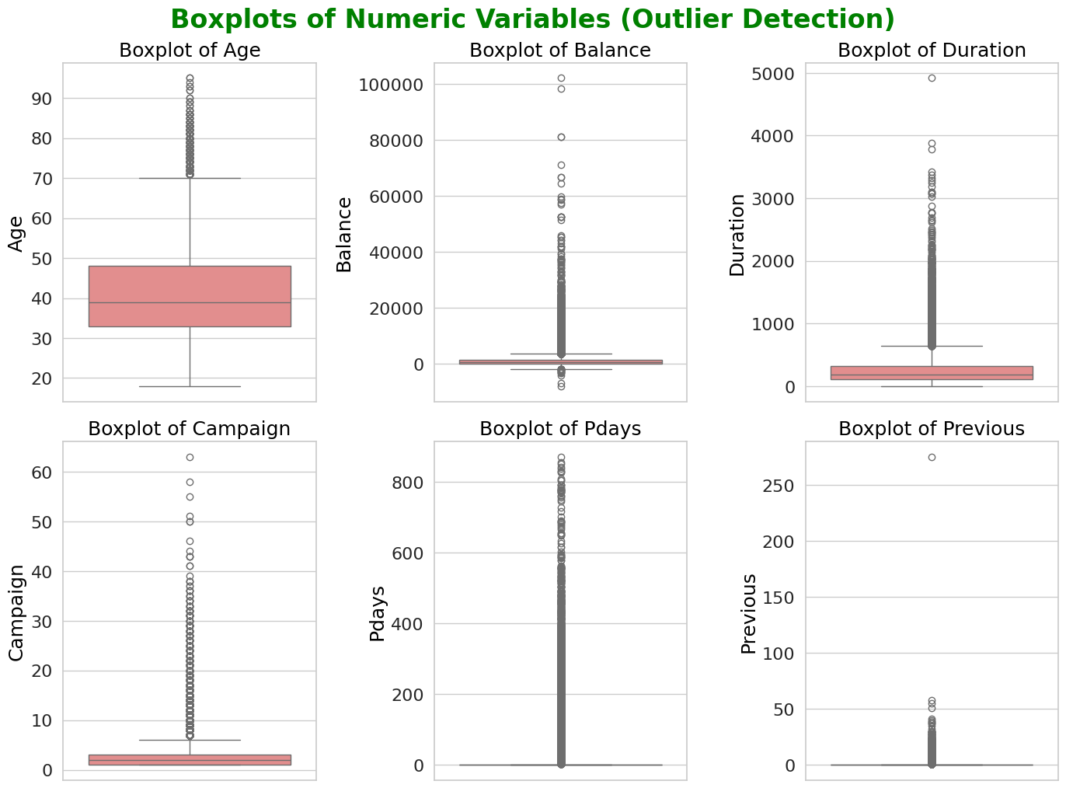
DESCRIPTIVE ANALYSIS CON’D
Fig. 8: Boxplots of Numerical Variables

Slide 12
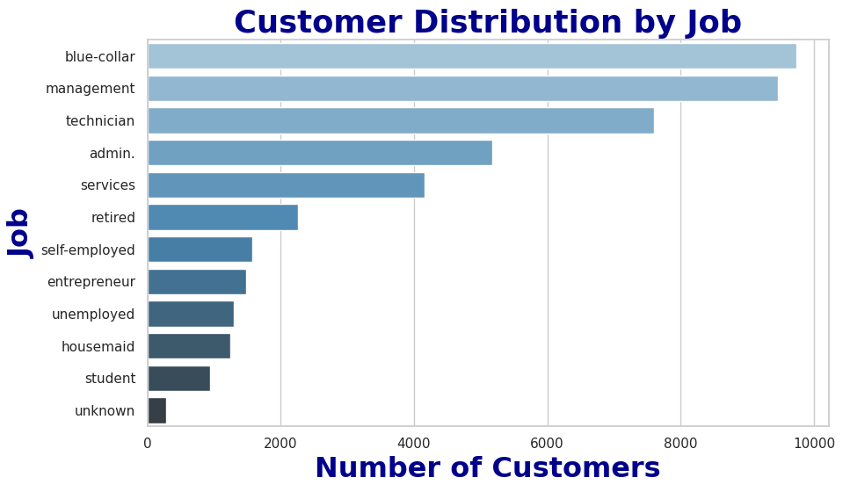
DESCRIPTIVE ANALYSIS CONT’D
Summary statistics indicate that:
Most clients were aged 30–40, married, have blue-collar jobs, and secondary educated.
Fig. 2: Customer’s Distribution by Job

Slide 13
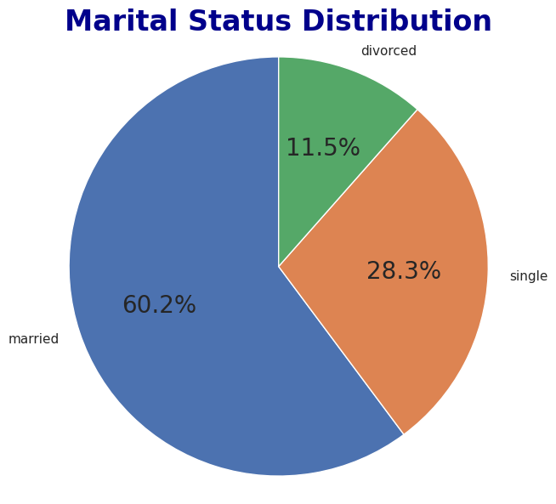
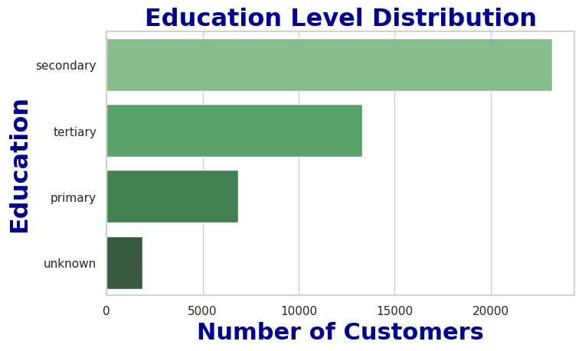
DESCRIPTIVE ANALYSIS CONT’D
Fig. 3: Customer’s Distribution by Marital status and Education level

Slide 14
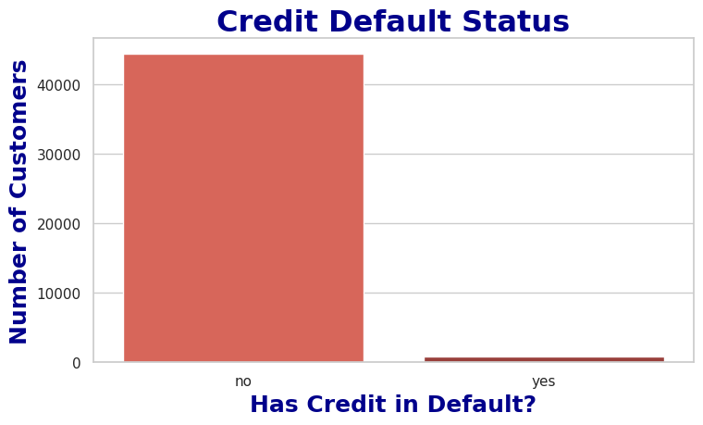
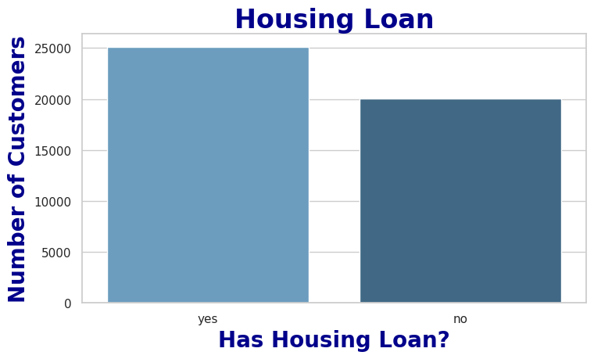
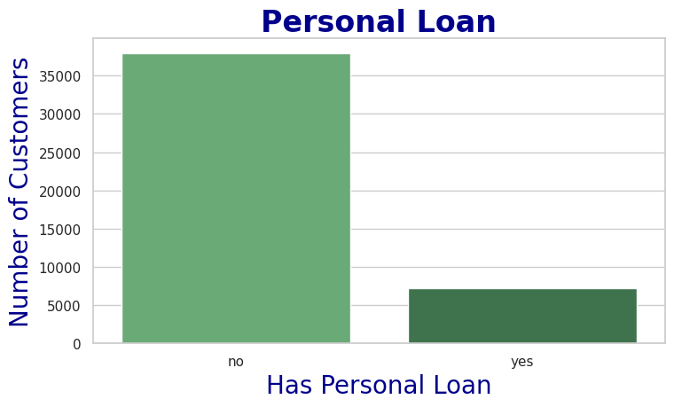
DESCRIPTIVE ANALYSIS CONT’D
Fewer customers had credit in default, and personal loans, with majority having a housing loan.
Fig. 4: Customer’s Distribution by Default, Housing and Personal loan

Slide 15
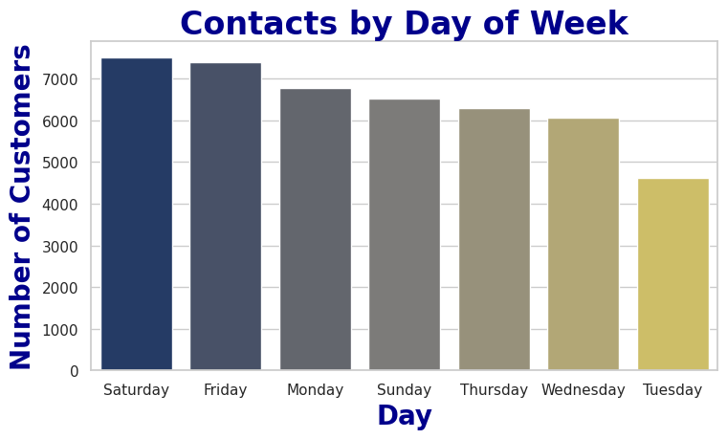
DESCRIPTIVE ANALYSIS CONT’D
Majority of the customers were contacted on Saturdays in May month via cellular calls and the outcome of the previous campaign (Poutcome) was unknown.
Fig. 5: Contact by Day_of_week

Slide 16
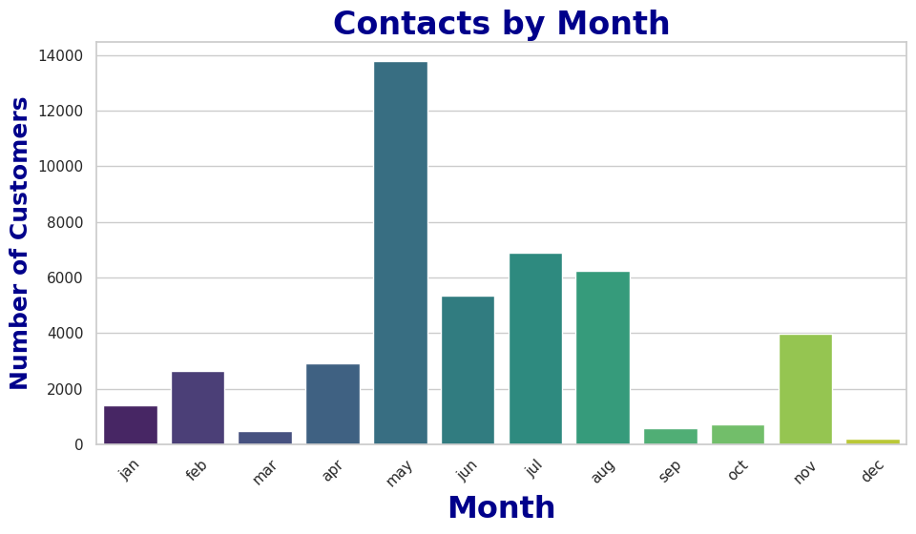
DESCRIPTIVE ANALYSIS CONT’D
Fig. 6: Contact by month

Slide 17
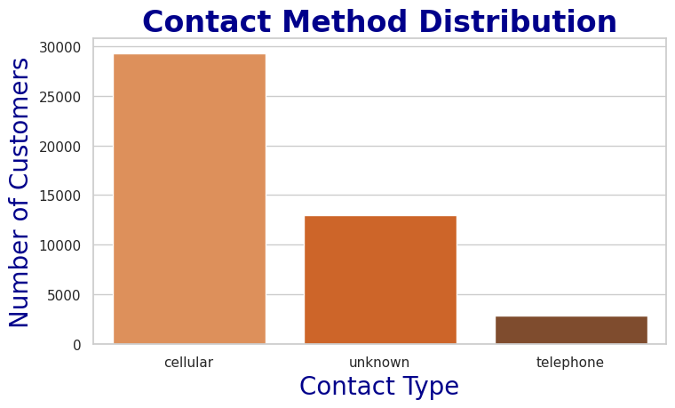
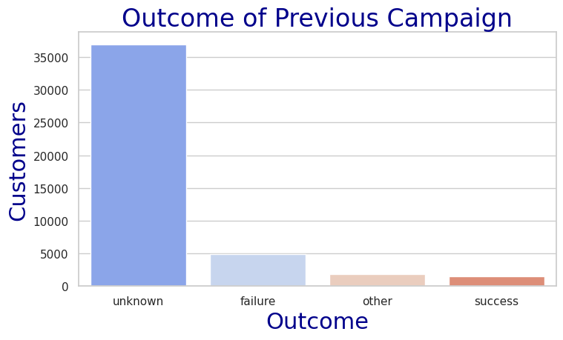
DESCRIPTIVE ANALYSIS CONT’D
Outcome of he previous marketing campaign (Poutcome) is mostly unknown suggesting most customers have no prior campaign history or no usable record.
Fig. 7: Outcome of the Contact Method and Previous Campaign (Poutcome)

Slide 18
RESULTS AND DISCUSSION

Slide 19
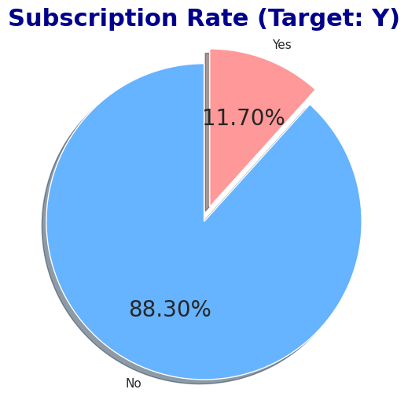
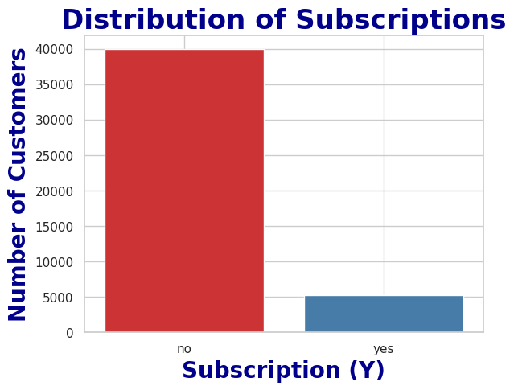
EDA Visualization (Distribution & Trends)
Fig. 9: Distribution of the Target Variable (Y) and percentage subscribed to the term deposit.

Slide 20
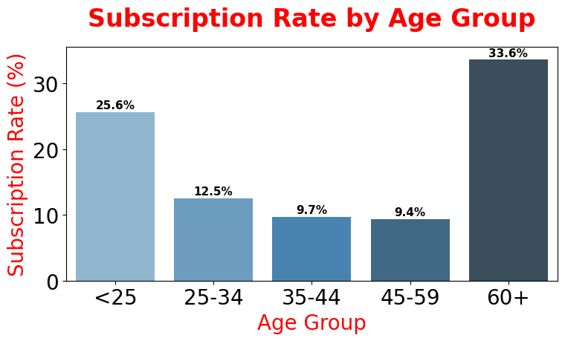
SEGMENTATION ANALYSIS
Highest term deposit subscribers:
60+ years
25-40 years
Clients aged 60 years and above are more likely to subscribe to the term deposit, followed by clients in the 25-40 years age bracket.
Fig. 10: Subscription Rates by Age

Slide 21
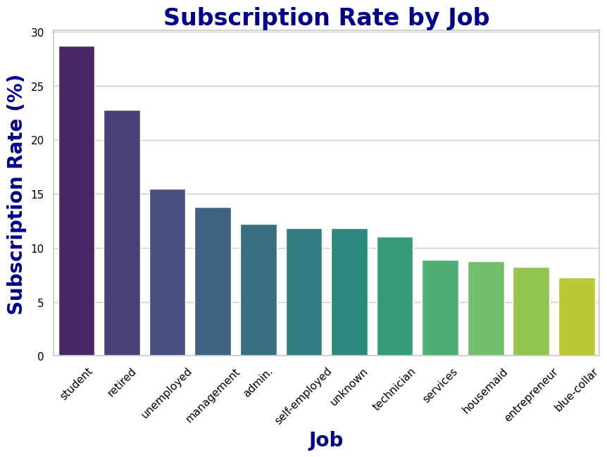
SEGMENTATION ANALYSIS CONT’D
Students, singles, and highly educated (tertiary) clients showed higher subscription rates, while loan holders were less likely to subscribe.
Fig. 11: Subscription Rates by Job

Slide 22
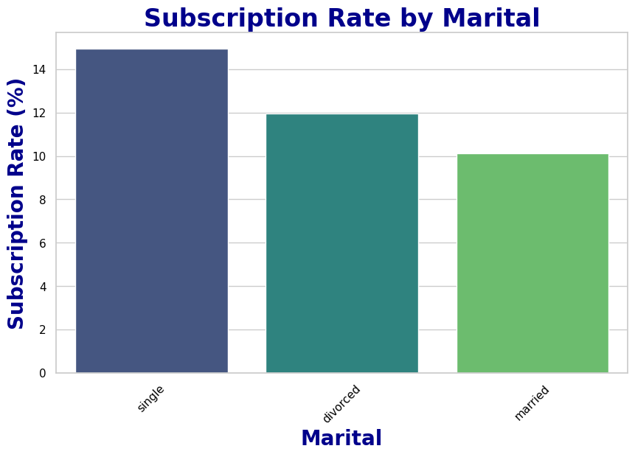
SEGMENTATION ANALYSIS CONT’D
Single clients shows higher subscription rates compared to married or divorced clients. Single individuals are more likely to subscribe, possibly due to fewer financial dependencies and greater flexibility in decision-making.
Fig. 12: Subscription Rates by Marital status

Slide 23
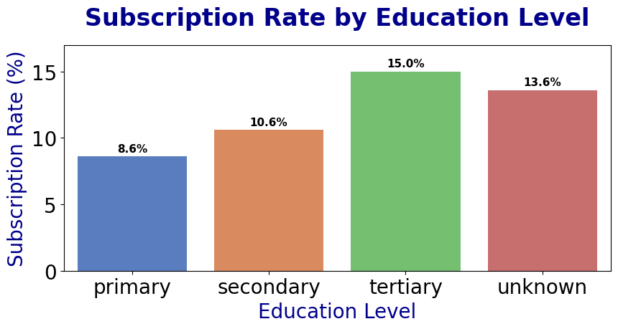
SEGMENTATION ANALYSIS CONT’D
Fig. 13: Subscription Rates by Marital status and Education level

Slide 24
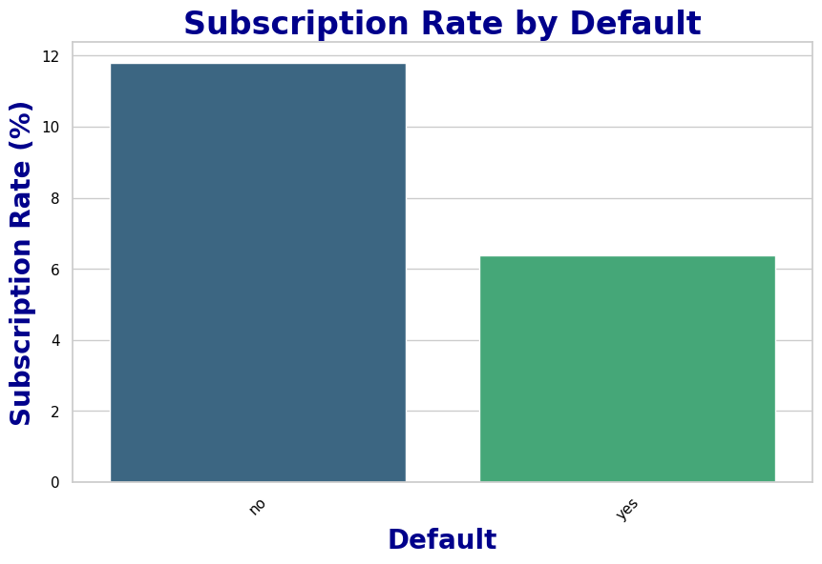
SEGMENTATION ANALYSIS CONT’D
Financial Indicators: Loans reduce subscription likelihood, so, Clients without loans may have free income to save. Clients are more likely to subscribe if they:
Have no defaults
Have no loans
Maintain higher
account balances
Fig. 14: Subscription Rates by Default

Slide 25
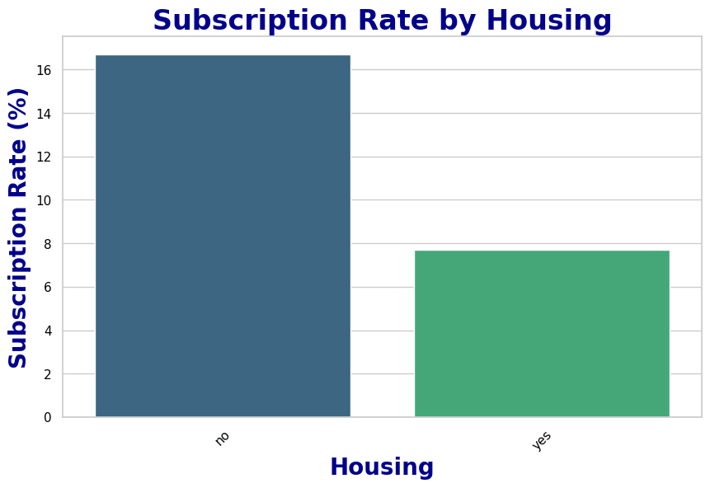

SEGMENTATION ANALYSIS CONT’D
Fig. 15: Subscription Rates by Housing and Loan status

Slide 26
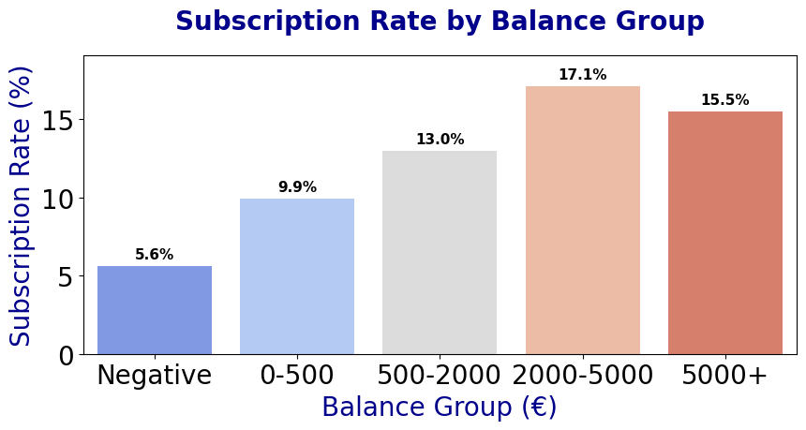
SEGMENTATION ANALYSIS CONT’D
Balance: Higher balances suggest higher subscription rates; therefore, customers with negative balances are the least likely to subscribe.
This confirms that financial capacity is a strong predictor of term deposit subscription.
Fig. 16: Subscription Rates by Balance

Slide 27
SEGMENTATION ANALYSIS CONT’D
Pdays: The more recently a client is contacted, the higher the chance they will subscribe.
Lower Pdays: Customers who were contacted more recently are more likely to subscribe
Higher Pdays: Customers who have not been contacted for a long time are less likely to subscribe.
Customers never contacted: less likely to convert possibly due to lack of awareness.
Table 3: Subscription Rates by Pdays
S/N | Pdays Range | Expected Subscription Trend
1 | 0–7 days | Very high conversion – extremely warm leads
2 | 8–30 days | Strong performance – still engaged
3 | 31–90 days | Moderate conversion
4 | 91–365 days | Lower conversion – interest fades
5 | 365+ days | Very low conversion

Slide 28
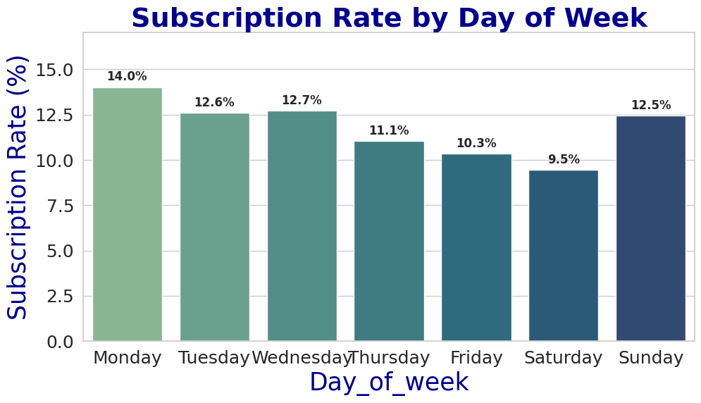
TEMPORAL TRENDS
Week
Best days: Monday, Tuesday, Wednesday and Sunday. This are the best days to reach clients, because they may be more open to financial decisions at the start of the week.
Worst: Friday, and Saturday. Possibly because it is a weekend and people are unwinding.
Fig. 22: Subscription Rates by Week

Slide 29
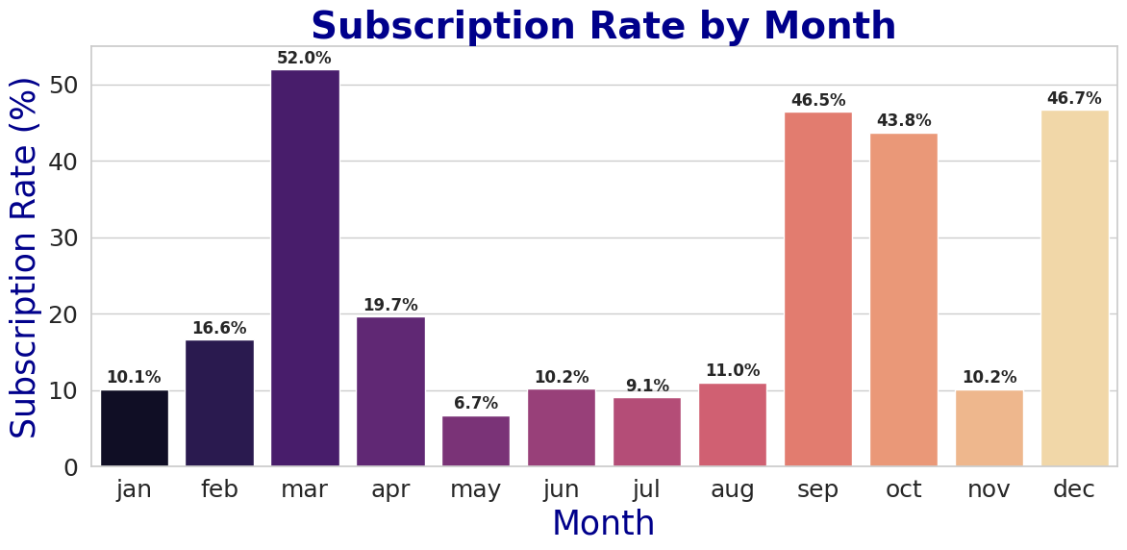
TEMPORAL TRENDS CONT’D
Month:
Best months: March, September, October, December. This could be due to seasonal effect, maybe March is tax refund season or bonuses; or it may be linked to vacation planning.
Worst: May. This may be due to lower receptiveness, or less strategic timing.
Fig. 18: Subscription Rates by Month

Slide 30
CUSTOMER PROFILING
Table 4: High-Value and Low-Value Customer Segments
Feature | Clients | Description
High-Value Segments | Student | Shows high subscription rate
 | Retired
 | Singles
 | Tertiary-educated
 | No loan/default history
 | Contacted recently (7–30 days) via cellular (mobile)
 | Contacted in March/September
 | Called early in the week (Sun, Mon, Tue, and Wed) and in (May, or September) month
Low-Value Segments | Blue-collar | Tend to have lower response rates
 | Married + low education (primary)
 | Clients with multiple loans
 | Negative account balances

Slide 31
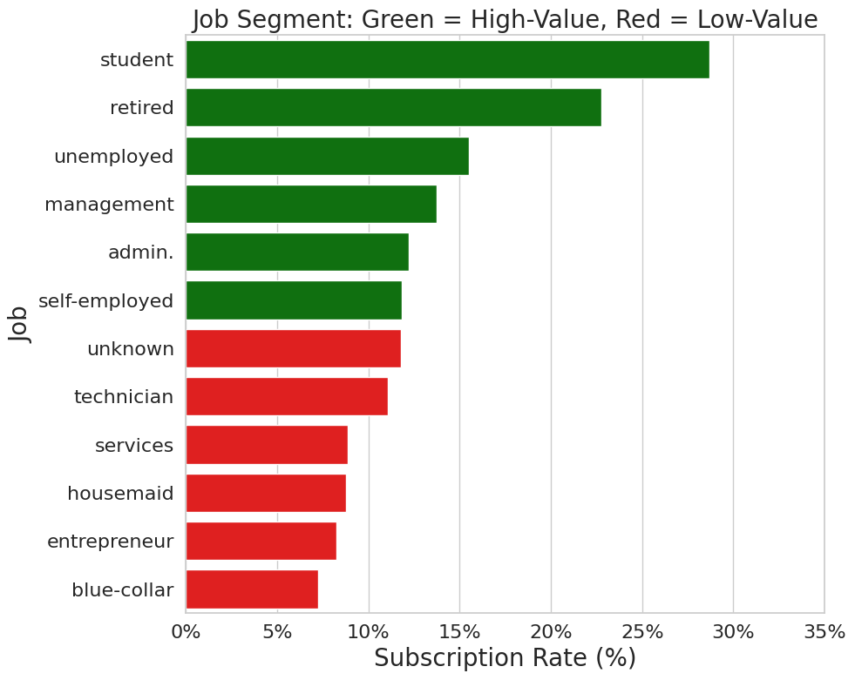
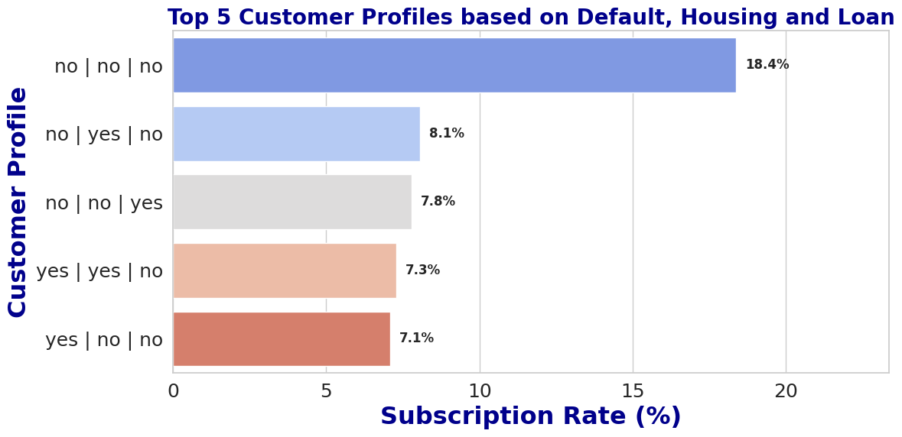
CUSTOMER PROFILING CONT’D
Fig. 19: High-Value and Low-Value Customer Segments by Job and Financial status

Slide 32
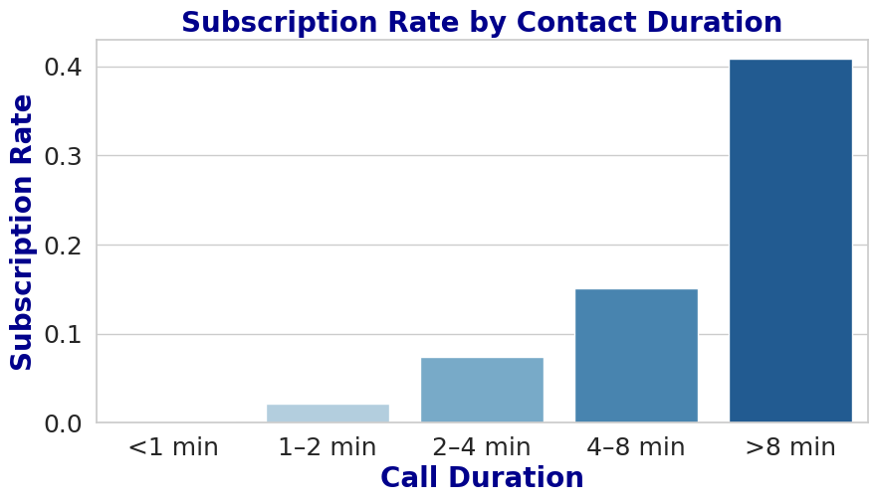
CONTACT STRATEGY EVALUATION
DURATION
Long calls (>4–8 minutes): Customers who engaged in longer conversations are more likely to convert, ask questions, receive explanations, and ultimately say "yes".
Short calls (<1 minute) rarely convert. Quick calls often indicate disinterest, busy customers, or early termination ("not now", "don't call again").
Fig. 23: Subscription Rates by Call Duration

Slide 33
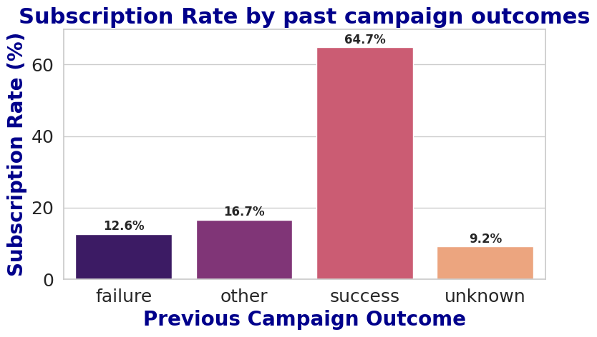
CONTACT STRATEGY EVALUATION CONT’D
POUTCOME
Success: Customers with a previous success outcome would be much more likely to subscribe again.
Other: This group indicates unclear history; mixed results
Failure: Customers with failure rarely convert, regardless of duration or effort.
Unknown: Indicates a lack of prior engagement but they may require longer calls to convert.
Fig. 24: Subscription Rates by Poutcome

Slide 34
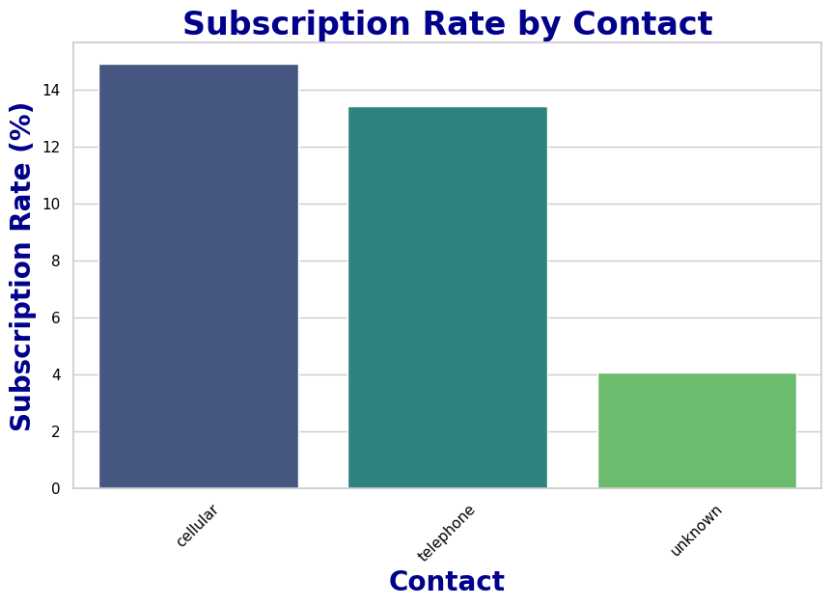
CONTACT STRATEGY EVALUATION CONT’D
Contact-Related Insights: Cellular contact yields higher conversion than telephone indicating that mobile outreach works well.
Unknown: equal low subscription connoting missing data, but confirms direct cellular contact is more effective than older landline methods.
Fig. 26: Subscription Rates by Contact

Slide 35
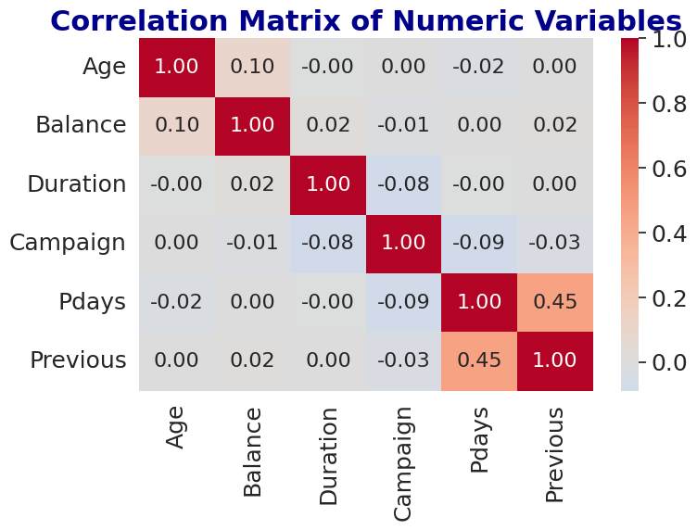
CORRELATION ANALYSIS
Strong Correlation: Pdays and Previous are the strongest correlation in the matrix. It means that customers who were contacted previously (Previous) tend to have been contacted more recently (Pdays) in previous marketing campaigns.
Weak Correlation: Overall, most numerical variables exhibit very weak correlations with coefficient close to 0 indicating they are independent of one another. Age and Balance show a weak positive correlation (r=0.10), suggesting that older customers tend to have slightly higher account balances, although the relationship is negligible.
Fig. 27: Correlation Matrix (Heatmap)

Slide 36
MODELLING RESULTS
Best Model: Random Forest (AUC = 0.85) SMOTE) achieved the best balance.
Top predictors: Duration, Poutcome, Balance, Age, Job.
Despite high accuracy, the AUC of 0.85 confirms the model has strong discriminative power between subscribers and non-subscribers.
Business Implication: The model can be used to score leads before outreach, prioritizing those with high predicted probability (e.g., retired, previously successful, high balance).
Table 4: Modeling
Model | Precision (Sensitivity) | Recall (Yes) | Accuracy | ROC AUC
Random Forest (SMOTE) | 0.48 | 0.28 | 88% | 0.85
Logistic Regression | 0.43 | 0.29 | 87% | 0.84
XGBoost | 0.46 | 0.29 | 87% | 0.85
Decision Tree | 0.27 | 0.33 | 81% | 0.78

Slide 37
MODELING RESULTS CONT’D
Top 5 Most Important Features:
Duration – Call length (strongest predictor)
Poutcome – Previous campaign result
Balance – Customer’s financial capacity (strongest predictor)
Age – Older customers likely more responsive
Job – Student, retired
Limitations
Imbalanced Data: Requires careful modelling to avoid bias toward "no".
"Unknown" Values: Some fields (e.g., education, job) have missing data, potentially biasing results.

Slide 38
ETHICAL GUIDELINES
Ethical considerations are central to any data analytics project, particularly when working with customer information.
The dataset contains no personally identifiable information (PII)
Methods such as SMOTE were used to reduce model bias toward the majority class
No variables suggesting sensitive attributes (race, ethnicity, religion) were used
Care is taken to prevent discrimination based on non-relevant demographic attributes (e.g., age or marital status) when interpreting or applying insights
Results are communicated honestly, emphasizing limitations such as class imbalance. Model predictions are not presented as absolute truths but as supportive tools for decision-making

Slide 39
CONCLUSION
Customer behaviour varies strongly across demographic and financial segments. The analysis reveals:
Subscription rates are low (11.7%) and many customers were contacted via cellular method
Many clients were never contacted in previous campaigns (pdays=871)
Certain customer profiles, such as students and singles with tertiary education, shows high subscription likelihood.
March, September, October, and December are the most successful months for conversion, with Sunday, Monday, Tuesday, and Wednesday yielding the highest conversions.
Customers with a previous successful campaign outcome are prime targets for re-engagement.
Call duration and past outcomes are critical behavioural predictors
Predictive models with AUC ~0.85 show strong classification capability
Ideal Target Customer
Young students or retirees, singles, no loans, contacted recently via cellular preferably in March/September and on Sundays to Wednesdays, with past positive outcomes and long call engagement.

Slide 40
RECOMMENDATION
Prioritize high-value customer segments for targeted outreach e.g., students, retirees, singles, higher education, and clients without loans.
Focus contact in high-performing months/days (Sun–Wed, March/Sept)
Improve agent training to increase call engagement duration
Use predictive models to rank and target high-probabaility leads
Prioritize cellular contacts over telephone calls, keeping calls concise yet engaging
Prioritize customers with previous successes through loyalty offers or personalized communication
Reduce “unknown” values in attributes such as job, education, contact, and previous outcome (poutcome) by improving data collection processes.

